Slide 1
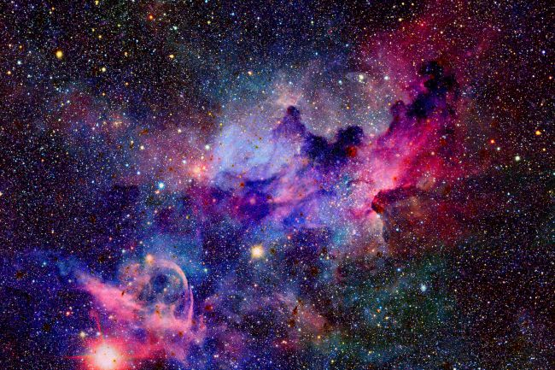
Hamiltonian Monte Carlo &
the No U-Turn Sampler
Why walk when you can flow?
Notes:
Juan

Slide 2

Objectives
Explore the Hamiltonian Monte Carlo (HMC) method
Introduce the probabilistic programming software Stan
Notes:
Paola

Slide 3


Let’s test your knowledge priors…
kahoot.it
GAME PIN:
Notes:
Juan

Slide 4




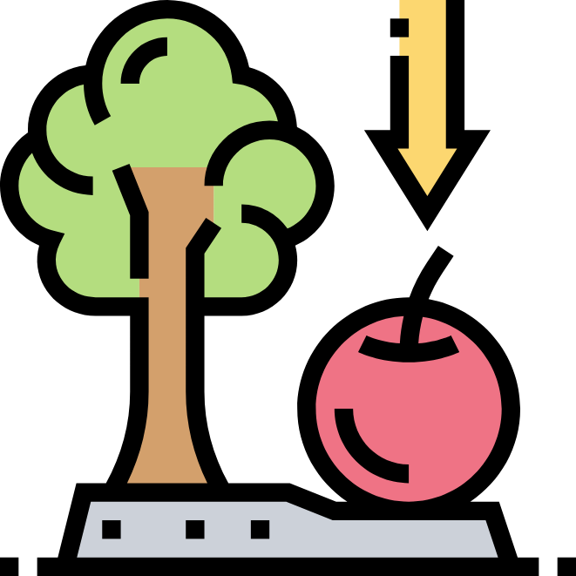

Agenda
Introduction
2. Algorithm
3. Implementation
Notes:
Paola

Slide 5
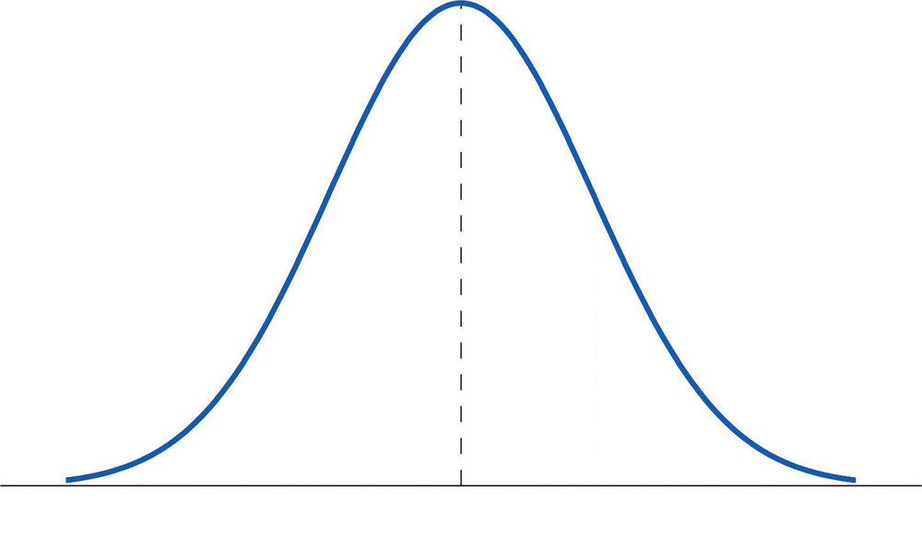



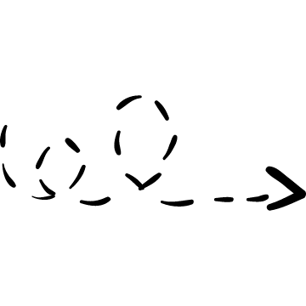


Introduction
Hamiltonian Monte Carlo Method is a sampling method.
Enhancement of Metropolis-Hastings
Stan is a programming language that uses the no-U-turn algorithm which is based on HMC.
Notes:
Paola

Slide 6

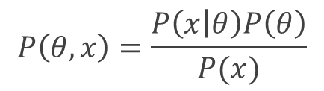
Motivation
Objective: Find posterior.
Alternatives:
Direct Simulation
Inverse CDF Method
Acceptance-rejection method
GIBBS Sampler
Metropolis-Hastings
$$P\left(θ,x\right)=\frac{P\left(x | θ\right)P\left(θ\right)}{P(x)}$$

Slide 7
History
BUGS is first released and revolutionizes Bayesian computation.
Improved by Hastings.
1953
1970
1983
1997|
2012
Metropolis et al. propose the eponymous algorithm.
Stuart and Donald Geman create the Gibbs sampling algorithm.
Stan, created by Andrew Gelman (yes, that Gelman) and Bob Carpenter and it is first released.
Notes:
Juan

Slide 8
STAN
Named in honor of Stanislaw Ulam (creator of the Monte Carlo methods).
Open source.
Written in C++.
Multi-interface (R, Python, Julia, command line, Matlab, Stata, possibly others).
Instead of relying in random walks, it’s inspired in statistical mechanics.¹
It can do much more than just sampling: optimization, variational inference, etc.
¹Necessary for the fundamental study of any physical system that has many degrees of freedom. The approach is based on statistical methods, probability theory and the microscopic physical laws.
Notes:
Juan

Slide 9
Agenda
Introduction
2. Algorithm
3. Implementation
Notes:
Paola

Slide 10


How does it work?
F(x)
-log(F(x))
Notes:
Juan

Slide 11

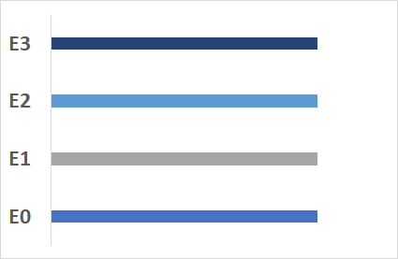
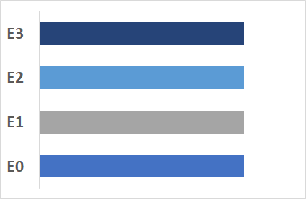



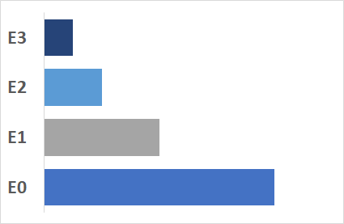


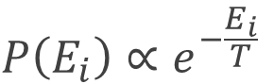
Mechanical Statistics
$$P\left(E_{i}\right)∝e^{−\frac{E_{i}}{T}}$$
Notes:
Paola

Slide 12
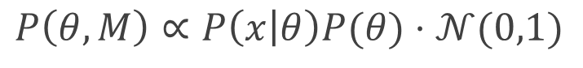
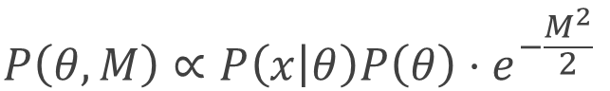

Energy of the system
$$P\left(E_{i}\right)∝e^{−\frac{E_{i}}{T}}$$
$$P\left(θ,M\right)∝P\left(x | θ\right)P\left(θ\right)⋅e^{−\frac{M^{2}}{2}}$$
$$P\left(θ,M\right)∝P\left(x | θ\right)P(θ)⋅𝒩(0,1)$$
Notes:
Paola

Slide 13

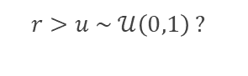
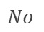
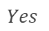

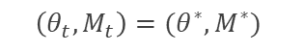
When do we accept proposals?
$$r=\frac{P\left(X | θ^{∗}\right)P\left(θ^{∗}\right)𝒩(M^{∗}|0,1)}{P\left(X | θ\right)P\left(θ\right)𝒩(M|0,1)}⋅\frac{P\left(θ,M | θ^{∗},M^{∗}\right)}{P(θ^{∗},M^{∗}|θ, M)}$$
$$No$$
$$r>u \sim 𝒰\left(0,1\right) ?$$
$$\left(θ_{t},M_{t}\right)=( θ_{t−1},M_{t−1})$$
$$Yes$$
$$\left(θ_{t},M_{t}\right)=(θ^{∗},M^{∗})$$
Notes:
Juan

Slide 14
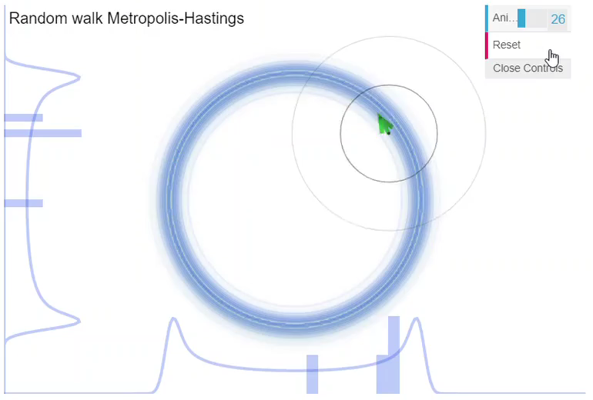
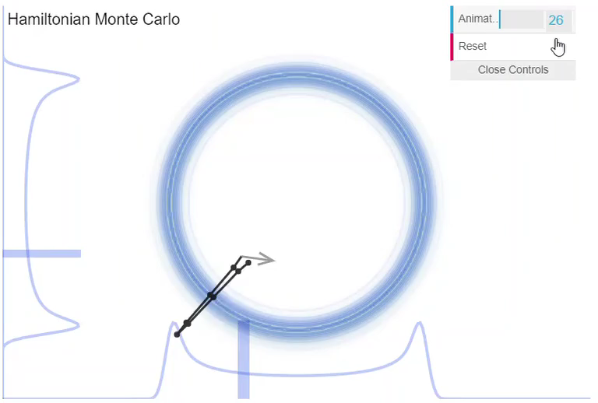
Metropolis Hastings vs HMC
Notes:
Paola
FALTA PONER DOS VIDEOS
EXPLICAR WHY WALK WHEN YOU CAN FLOW

Slide 15
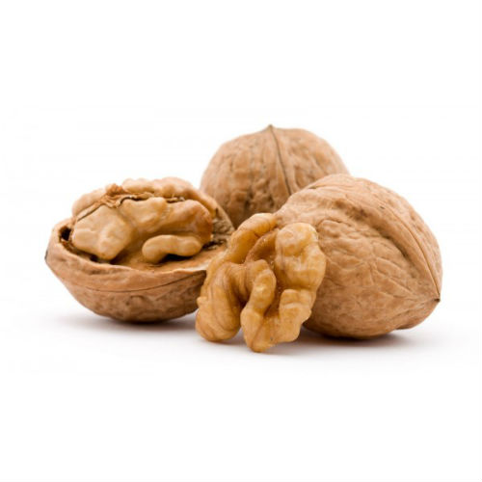
No U-Turn Sampler (NUTS)

Slide 16
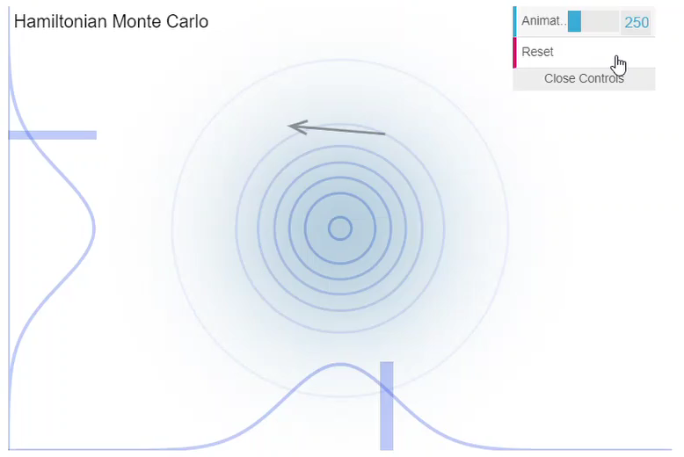
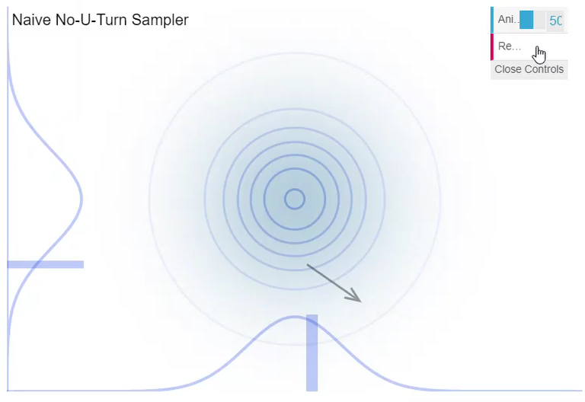
HMC vs No U-Turn
Notes:
Juan
FALTAN VIDEOS
VAMOS A PONER EN PPT
Explicar problema de HMC
There are still some improvements to be had. Hamiltonian Monte Carlo needs to be told how many steps to take in its simulated paths. The step number determines how long the path continues before a new flick is made in a new random direction. If it takes too few steps, then it ends up with samples too similar to one another. If it takes too many, it can also end up with samples too similar to one another. Why? Because the path eventually makes a U-turn. Here’s an example.

Slide 17
Agenda
Introduction
2. Algorithm
3. Implementation
Notes:
Juan

Slide 18
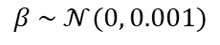
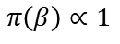
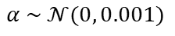
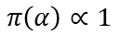
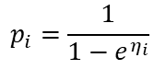
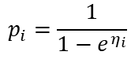
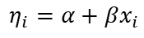
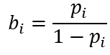
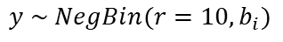
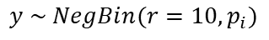
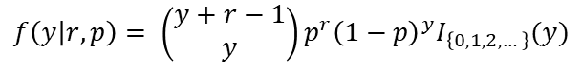
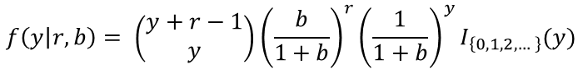
A duel to the death
JAGS
$$y \sim NegBin(r=10, p_{i})$$
$$y \sim NegBin(r=10, b_{i})$$
$$f\left(y | r, p\right)= \left(\begin{matrix}y+r−1 \\ y\end{matrix}\right)p^{r}{\left(1−p\right)}^{y}I_{\left\{0,1,2,…\right\}}(y)$$
$$f\left(y | r, b\right)= \left(\begin{matrix}y+r−1 \\ y\end{matrix}\right){\left(\frac{b}{1+b}\right)}^{r}{\left(\frac{1}{1+b}\right)}^{y}I_{\left\{0,1,2,…\right\}}(y)$$
$$η_{i}=α+βx_{i}$$
$$η_{i}=α+βx_{i}$$
$$p_{i}=\frac{1}{1−e^{η_{i}}}$$
$$p_{i}=\frac{1}{1−e^{η_{i}}}$$
$$b_{i}=\frac{p_{i}}{{1−p}_{i}}$$
$$α \sim 𝒩(0, 0.001)$$
$$π\left(α\right)∝1$$
$$β \sim 𝒩(0, 0.001)$$
$$π\left(β\right)∝1$$
Notes:
Juan

Slide 19
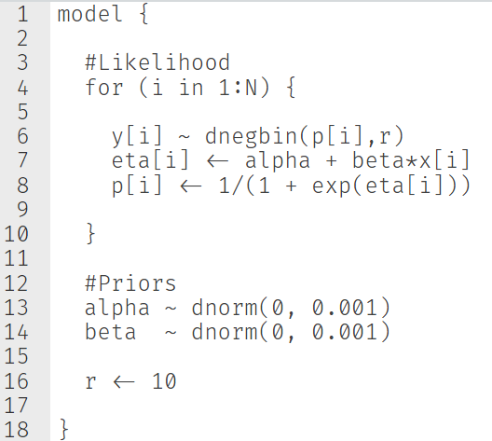
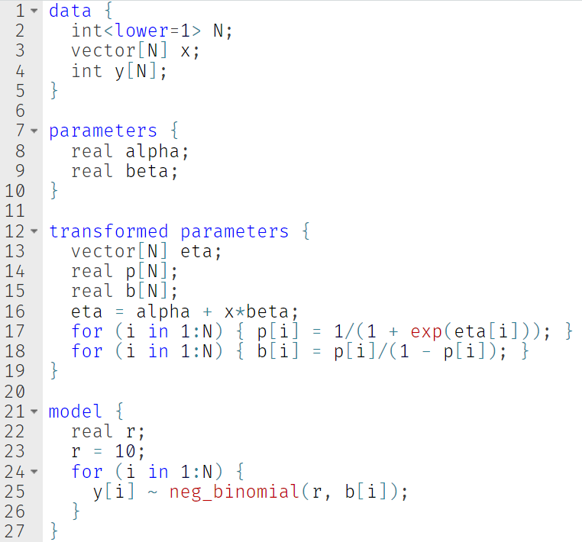
JAGS
Notes:
Juan

Slide 20
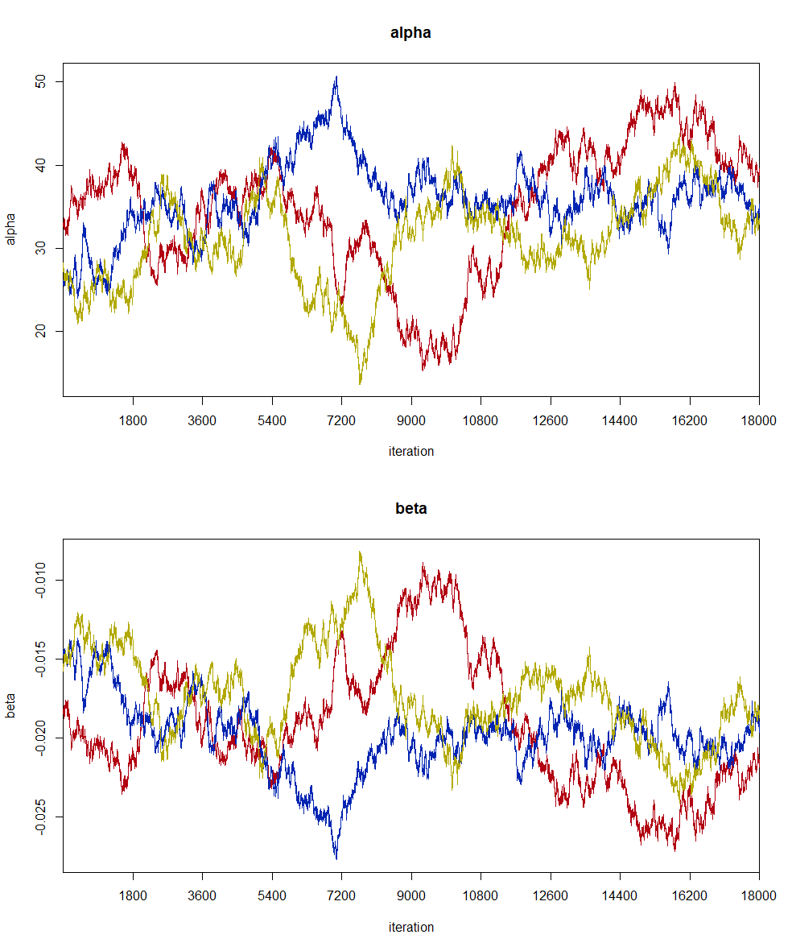
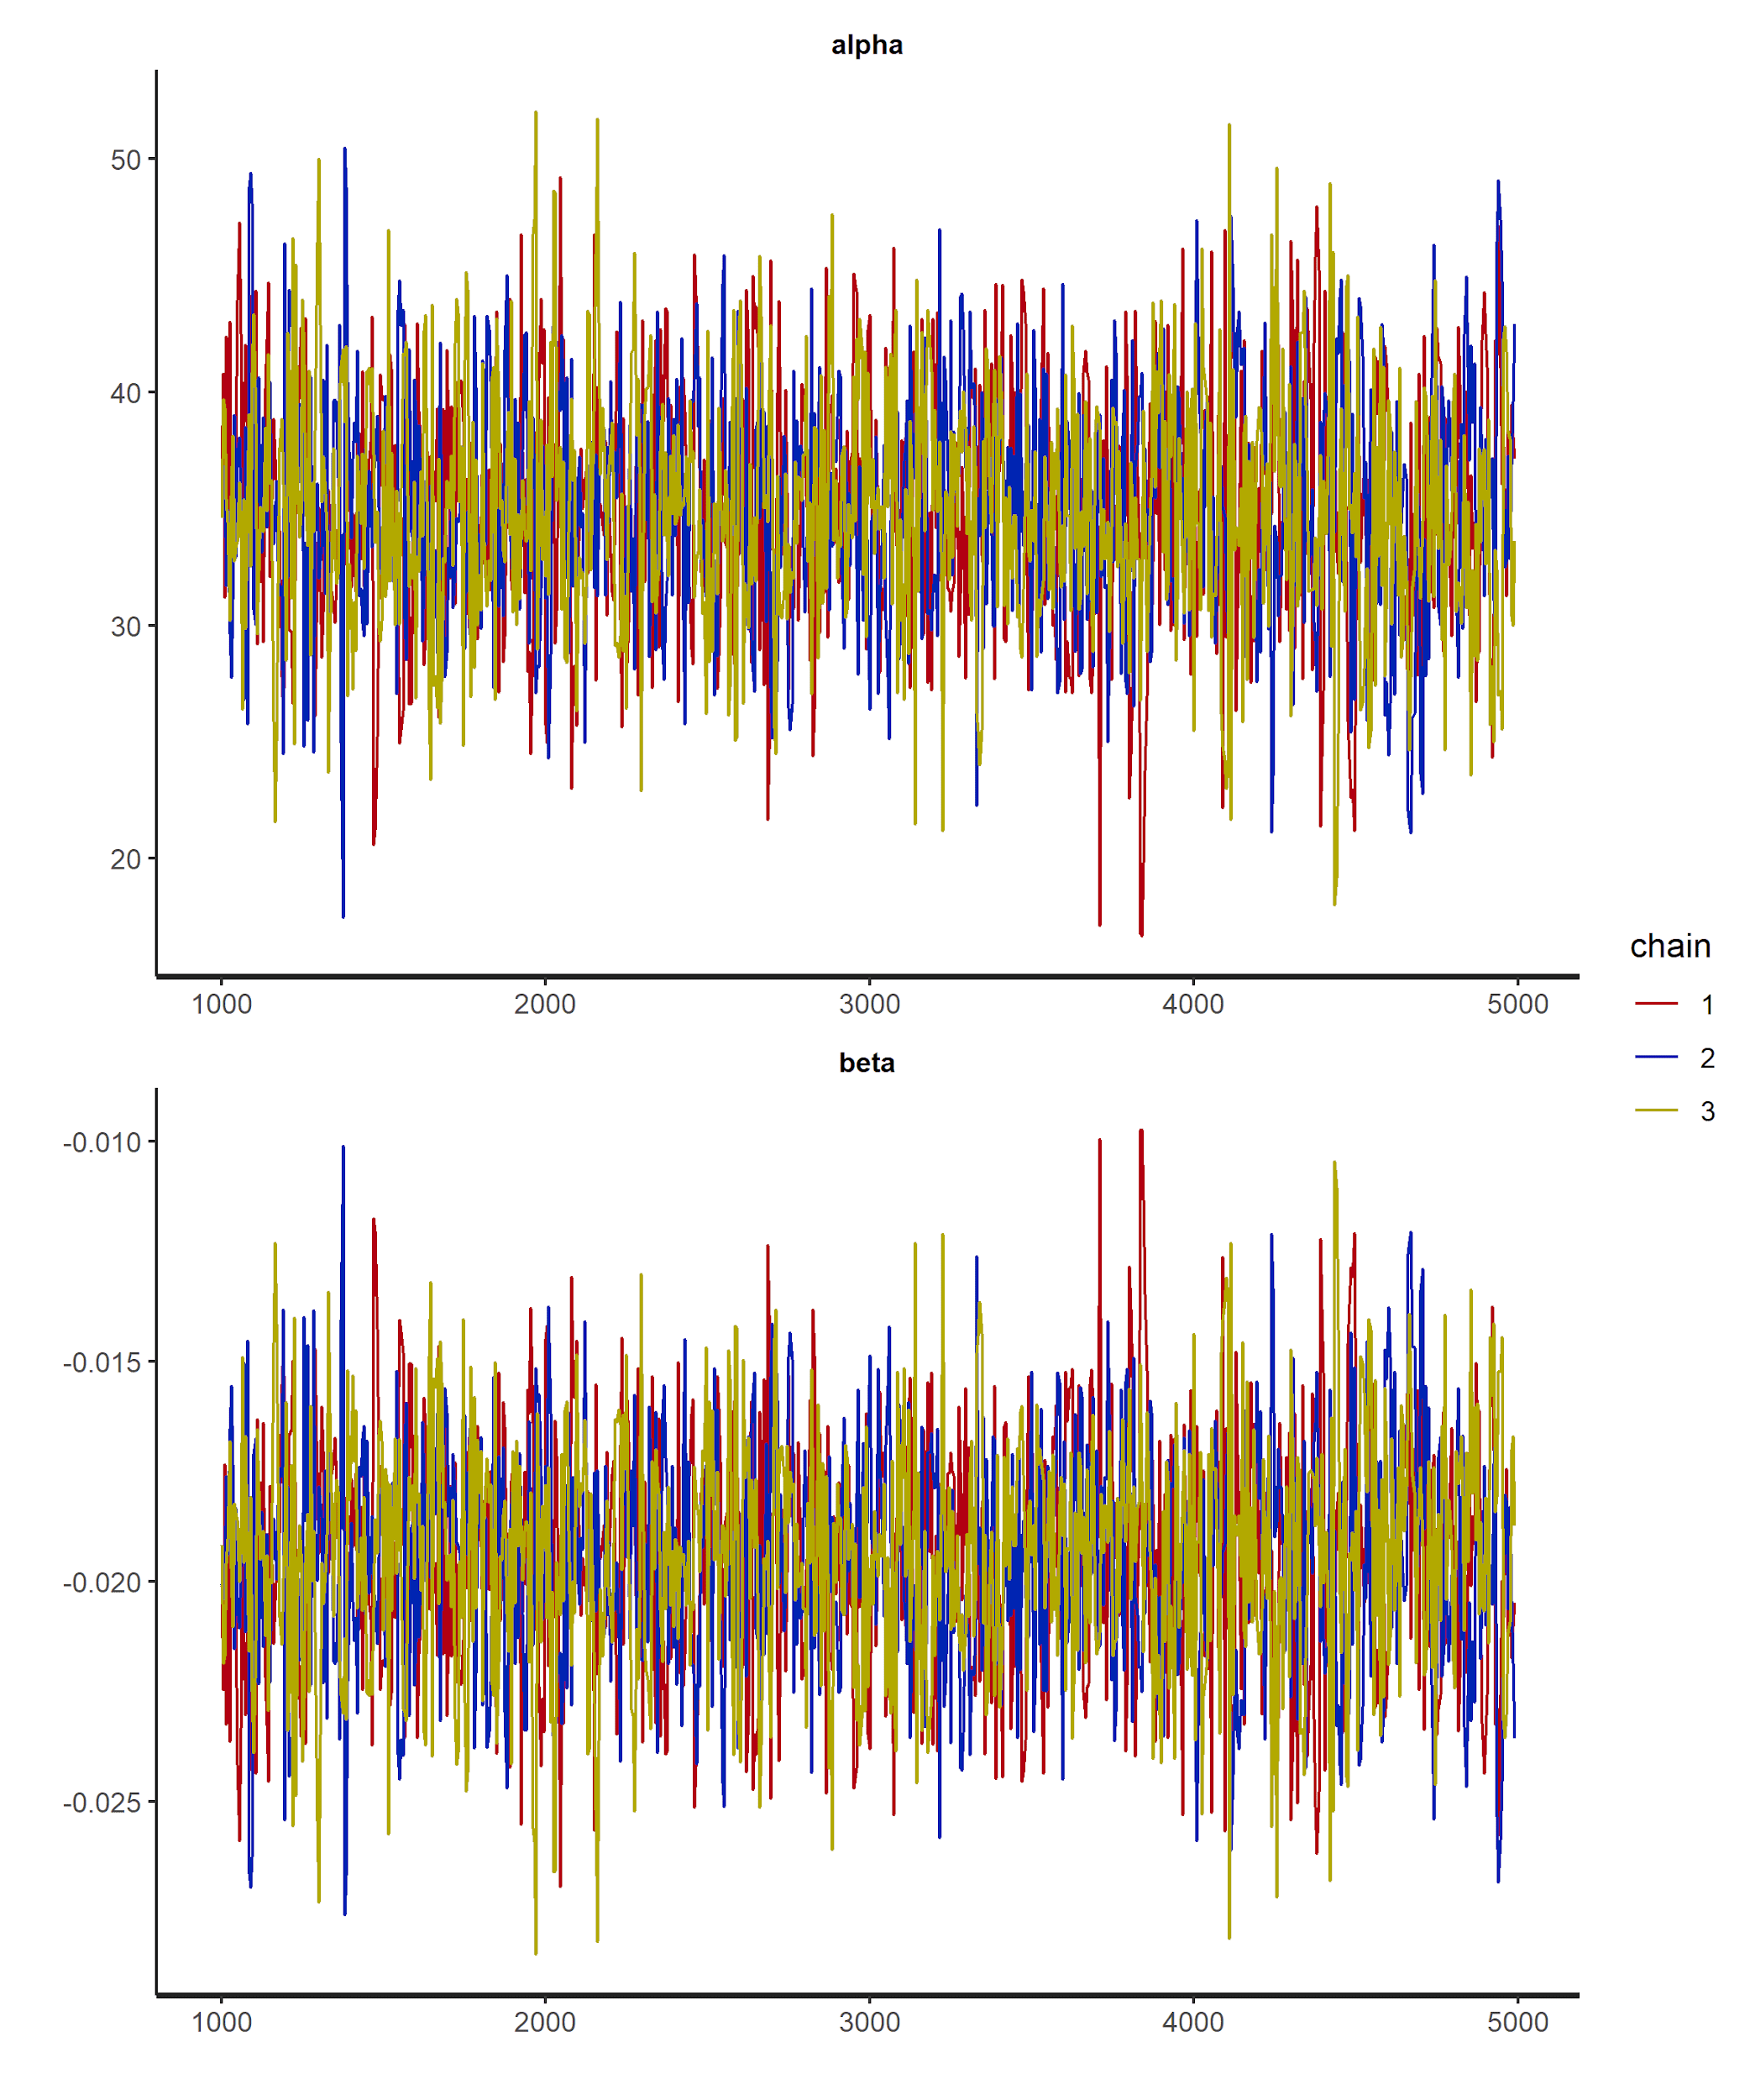
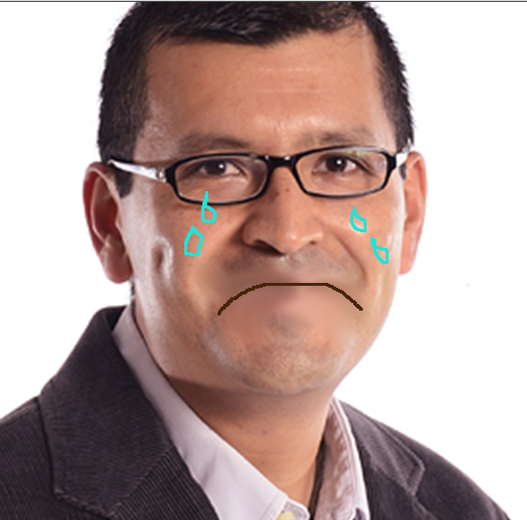
Notes:
Paola

Slide 21
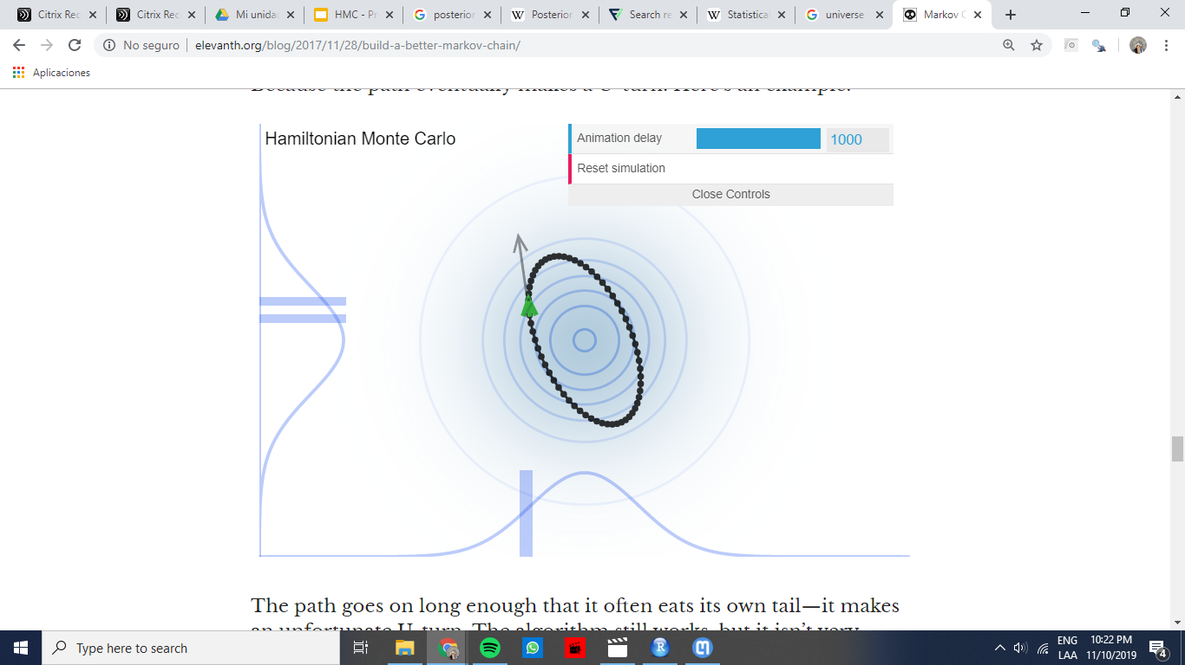
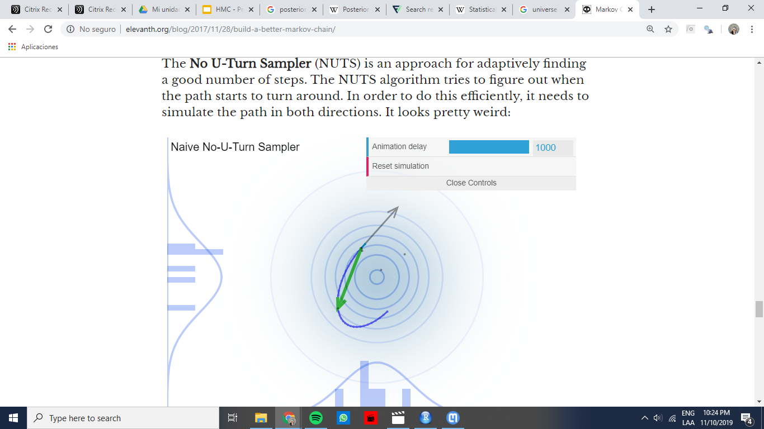
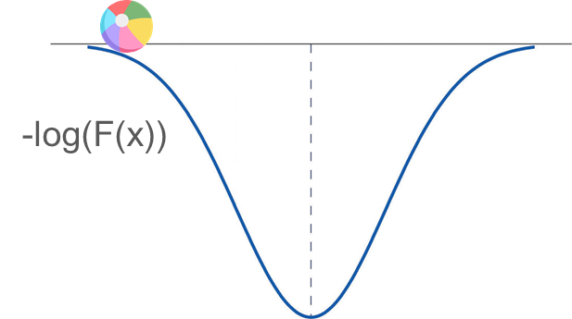
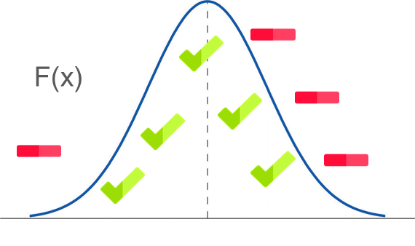

Takeaways
HMC an improvement of MH
Why walk when you can flow?
HMC works with momentum and energy from Statistical Mechanics.
The no U-Turn sampling is an improved version of HMC
Stan uses the no U-Turn algorithm
Stan is better than JAGS
Convergence and understanding probability
Notes:
Paola
Hamiltonian samplers can sample from such models, however. It just takes a little more work in thinking about the target distribution. This topic really needs its own post. I’ve written one here. An advantage of using Hamiltonian Monte Carlo for such models is that they often end up sampling much better than going the easy way and using Gibbs. I think another advantage is that it forces the user to understand the probability model better. This is not a small benefit, in my experience.

Slide 22
Want to learn more?
Betancourt, Michael. “Towards A Principled Bayesian Workflow”, 2018.
____________. A Conceptual Introduction to Hamiltonian Monte Carlo, 2018.
____________. The Geometric Foundations of Hamiltonian Monte Carlo, 2018.
Carpenter, Bob. “How not to compare the speed of Stan to something else”, 2017.
Gelman, Andrew; D. Lee; and J. Guo. “Stan: A probabilistic programming language for Bayesian inference and optimization”, 2015.
Rogozhnikov, Alexei. Hamiltonian Monte Carlo explained, 2016.
Stan User’s Guide
Installing Stan
Michael Betancourt’s written guides (much more than only Stan!)
Ben Lambert’s YouTube “The intuition behind the Hamiltonian Monte Carlo algorithm”.
Notes:
Juan

